Slide 1

SITA1301 – PROGRAMMING IN JAVA
Dr. S. Murugan

Slide 2
UNIT V – SWING & DATABASE CONNECTIVITY
SWING
JApplet
Jlabel
JCheckBox
JTextField
JButton
JComboBox
JRadioButton
JTabbedPane
JScrollPane
JTable
Database
Connection
Tables
Insert
Update
Delete
JDBC - API

Slide 3
Swing
Swing component are derived from JComponent
javax.swing

Slide 4
Classes
JApplet | JButton | JCheckBox | JCheckBoxMenuItem
JColorChooser | JComboBox | JComponent | JDesktopPane
JDialog | JEditorPane | JFileChooser | JFormattedTextField
JFrame | JInternalFrame | JLabel | JLayer
JLayeredPane | JList | JMenu | JMenuBar
JMenuItem | JOptionPane | JPanel | JPasswordField
JPopupMenu | JProgressBar | JRadioButton | JRadioButtonMenuItem
JRootPane | JScrollBar | JScrollPane | JSeparator
JSlider | JSpinner | JSplitPane | JTabbedPane
JTable | JTextArea | JTextField | JTextPane
JTogglebutton | JToolBar | JToolTip | JTree
JViewport | JWindow

Slide 5
Containers
First Level Containers (Heavy Weight) inherits JComponent
JFrame
Second Level Containers (Light Weight)
JPanel
JApplet
JWindow
JDialog

Slide 6
Packages
javax.swing | javax.swing.plaf.basic | javax.swing.text
javax.swing.border | javax.swing.plaf.metal | javax.swing.text.html
javax.swing.colorchooser | javax.swing.plaf.multi | javax.swing.text.html.parser
javax.swing.event | javax.swing.plaf.nimbus | javax.swing.text.rtf
javax.swing.filechooser | javax.swing.plaf.synth | javax.swing.tree
javax.swing.plaf | javax.swing.table | javax.swing.undo

Slide 7
Sample programs
Basic
Event
JLabel
JToggleButton
JTextField
JCheckBox
JRadioButton
JTabbedPane
JScrollPane
JComboBox
JTable

Slide 8
Layouts
Border Layout
The BorderLayout arranges the components to fit in the five regions: east, west, north, south, and center.
Card Layout
The CardLayout object treats each component in the container as a card. Only one card is visible at a time.
Flow Layout
The FlowLayout is the default layout. It layout the components in a directional flow.
Grid Layout
Grid Bag Layout
Group Layout
Spring Layout
The GridLayout manages the components in the form of a rectangular grid.
This is the most flexible layout manager class. The object of GridBagLayout aligns the component vertically, horizontally, or along their baseline without requiring the components of the same size.
The GroupLayout hierarchically groups the components in order to position them in a Container.
A SpringLayout positions the children of its associated container according to a set of constraints.

Slide 9
database

Slide 10
JDBC – JAVA DATABASE CONNECTIVITY
JDBC API is a Java API that can access any kind of tabular data, especially data stored in a Relational Database.
JDBC works with Java on a variety of platforms, such as Windows, Mac OS, and the various versions of UNIX

Slide 11
JDBC - API
Making a connection to a database
Creating SQL or MySQL statements
Executing SQL or MySQL queries in the database
Viewing & Modifying the resulting records

Slide 12
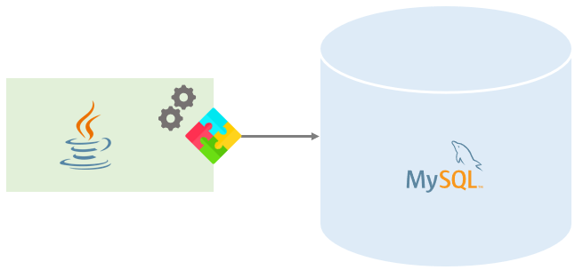
workflow

Slide 13
JDBC Driver
A JDBC driver is set of Java classes that implement JDBC interfaces for interacting with a specific database.
Almost all database vendors such as MySQL, Oracle, Microsoft SQL Server, provide JDBC drivers.
For example, MySQL provides a JDBC driver called MySQL Connection/J that allows you to work with MySQL database through a standard JDBC API.

Slide 14
phase
Connection
Load Driver
Establish Connection
Statement
Create
Execute
ResultSet
Process
Close
ResultSet
Statement
Connection

Slide 15
Sample programs
Connection
Insert
Update
Delete
Select
GUI
Create

